Slide 1
Web Application Testing Casuta Culorilor
Adriana Cionca Gr25

Slide 2
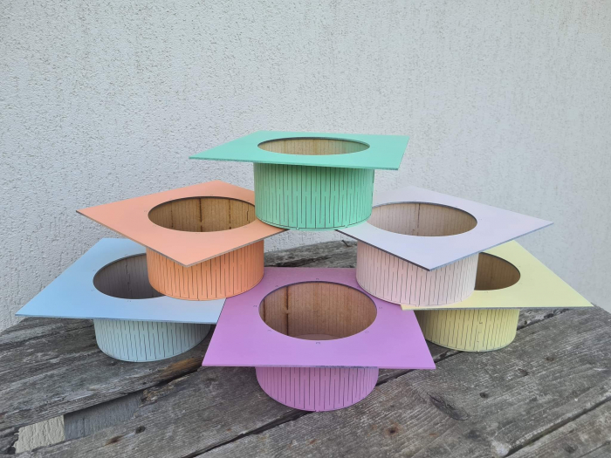
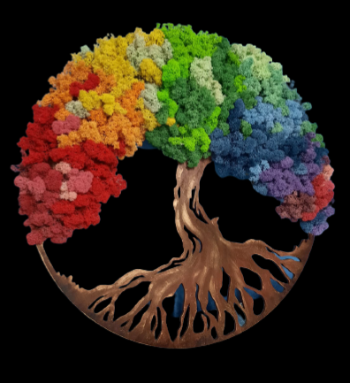
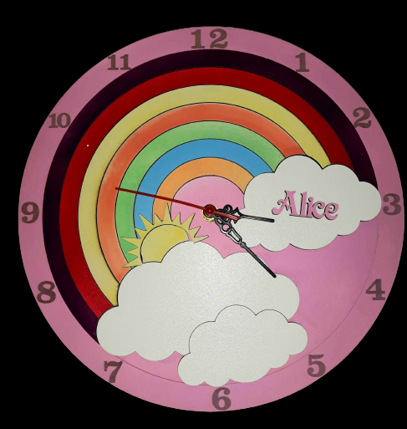
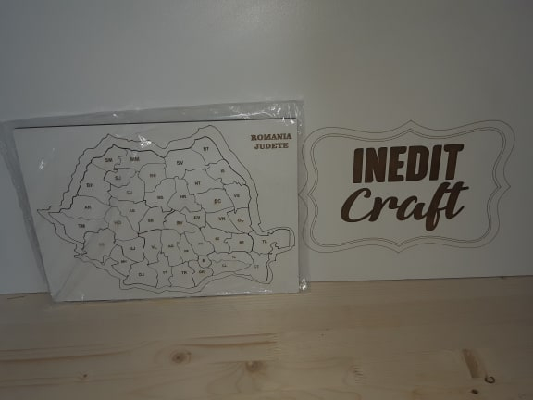
APP DESCRIPTION
Casuta Culorilor Online Store
Web application
Online store for a local MDF product workshop

Slide 3
TESTING APPROACH
SCOPE: Detecting Bugs in the Application using Functional and Non-functional Testing Types.
Exploratory Testing to decide if the application is a good candidate for the final project
Prioritize the importance of functionalities and create the mindmap
Write test cases and prepare test data file
Apply Component Testing, Integration, System, System Integration Testing
Execute the test cases and report the discovered bugs
Write the Test Report

Slide 4
TOOLS USED
Mantis Bug Tracker – Bug Reporting
TestLink – Test Case Management
Snipping Tool – Screenshots Capture
Xmind Tool – Mind Maps

Slide 5
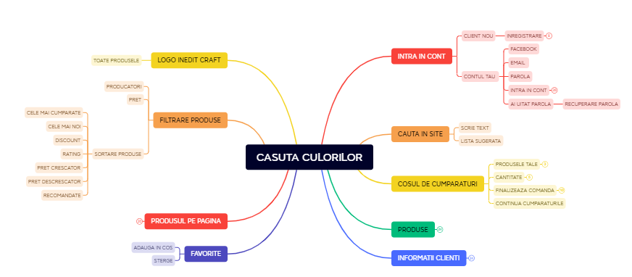
MINDMAP

Slide 6
TESTING TIPES
PERFORMED APPLICABLE
Ad-Hoc Testing - Performance Testing
Smoke Testing - Security Testing
Positive Testing
Compatibility Testing
Exploratory Testing
Stress Testing
UI Testing
Negative Testing

Slide 7
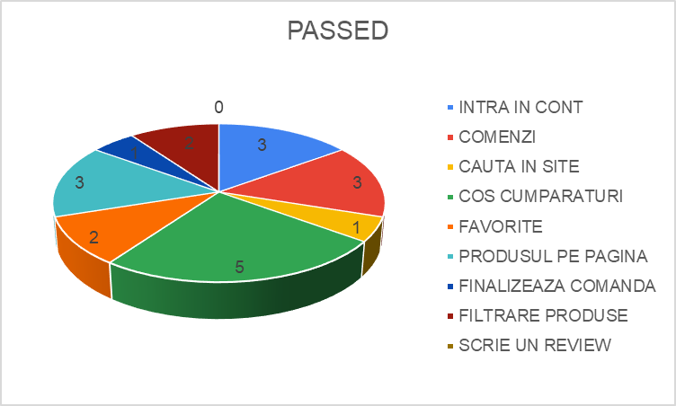
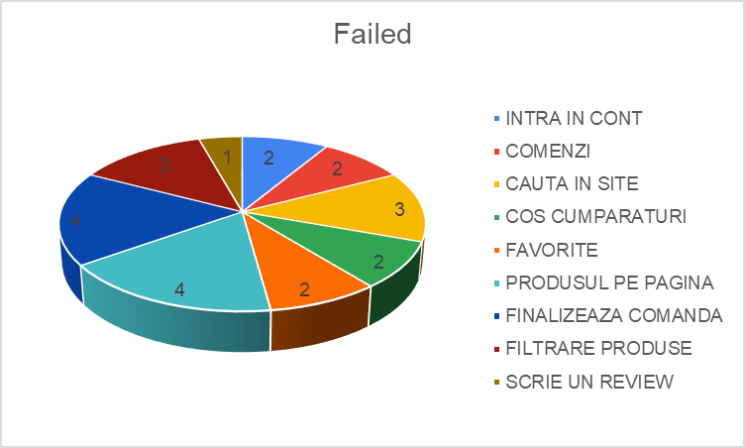
BUGS OVERVIEW

Slide 8
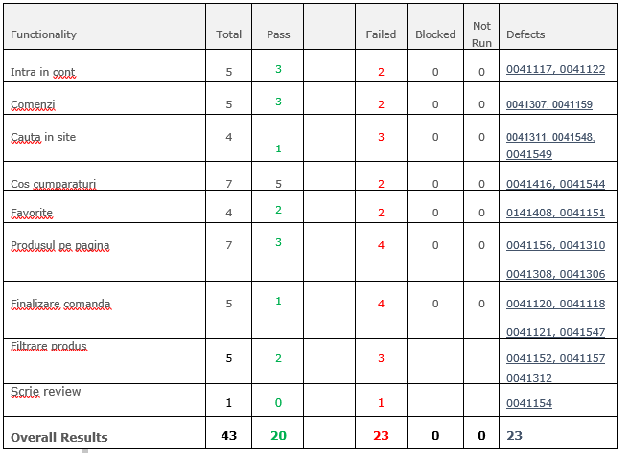
TEST CASE OVERVIEW

Slide 9
CONCLUSION
Conclusions
Test Cases for the main functionalities in a percent of 100% were executed, 41.43% passed and 58.57% failed. Most of the failed test cases are related to the “Produsul pe pagina” and “Finalizeaza comanda” functionalities.
A total number of 23 new defects were identified, 13 bugs and 10 improvements. 7 of the bugs were identified as major severity and 6 as normal severity. No bugs were validated. The improvements were identifies have normal severity.
The most frequent testing types applied were Functional Testing, Exploratory, Compatibility, Negative, UI, Usability.
Exploratory testing was performed for important functionalities. Most of the defects were improovement and were related to the aesthetics and the writing of the text.
Most of the bugs were identified by performing Negative Testing.
Compatibility testing was also performed, for different browsers and devices. The bugs could be reproduced on all browsers. In addition to the bugs identified on Windows OS, that also reproduce on Android.
Considering the number of high severity bugs detected on important functionalities, the fixing of at least the major severity bugs is recommended. Going live with this website was a decision that could harm the marketing image of the company, the identified bugs having a negative impact especially on the customers shopping experience.
From my point of view a lot of improvement is needed.

Slide 10
LESON LEARNED
CHALENGES:
Finding an Application for the project
Writing the test cases
Covering more types of testing
Using too much invalid data in production
LESSONS:
The testing is a very organized process with clear steps and results.
Testing can be challenging but satisfying
Small steps→big results

Slide 11
THANK YOU

